Slide 1

Used Car Price Estimator
Adam Six, Car Enthusiast

Slide 2

Problem Statement
To provide a tool that estimates the price of a few common racecars
Target Audience: People like myself interested in racing
Introduction
Background
Methodology
Issues/Outcomes
Conclusion
Problem Statement

Slide 3

Introduction
Car/Racing Enthusiast
Sifting through websites
In the market for a car
Trying to kickstart a racing career as cheap as possible
Introduction
Background
Methodology
Issues/Outcomes
Conclusion
Problem Statement

Slide 4




Background
Craigslist, eBay, TrueCar for websites to scrape
Common cheap track/performance cars
Ford Mustang, Nissan 350z, Subaru WRX, Mazda Miata
Looking at Engine, Mileage, Color
Linear regression to estimate car prices
Introduction
Background
Methodology
Issues/Outcomes
Conclusion
Problem Statement

Slide 5

Methodology
Constants
Domestic, Clean Title, Manual, 1980 - 2021
Separate scripts for each site
Compare columns for each site
Find/Rename the Engine/Mileage/Price columns to match
Remove missing results
Combine Data
Process with Linear Regression/Gradient Descent
Introduction
Background
Methodology
Issues/Outcomes
Conclusion
Problem Statement

Slide 6

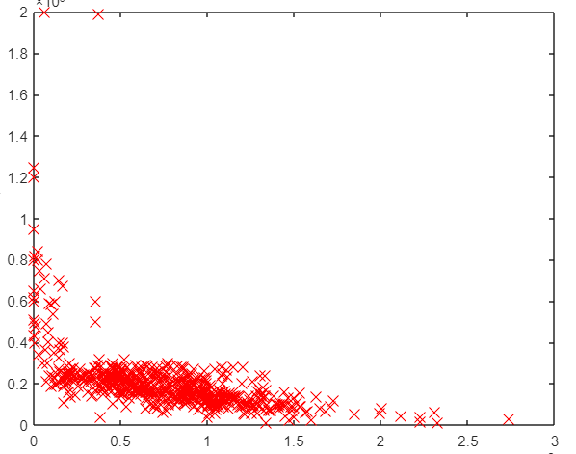
Issues
Outcomes
eBay Sold Items
Varying syntax/variable names per html
Minimal Results for 350z on eBay, Craigslist
All engine labels not created equal
Gradient Descent Algorithm
Mustangs are the most common
350z least common
Price of Miata about equal to Mustang
Price
Mileage
Introduction
Background
Methodology
Issues/Outcomes
Conclusion
Problem Statement

Slide 7

Conclusion
Would like more sites
Cars.com, AutoTempest
I suggest looking at as many parameters for more accurate estimations
Highly recommend contact with web services
Future possibilities
Type in car with parameters, scans internet and provides report
Introduction
Background
Methodology
Issues/Outcomes
Conclusion
Problem Statement

